Slide 1

Subject Code
18MEO113T - Design of Experiments
Handled by
S. Murali, Ph.D.,
Associate Professor,
Department of Mechanical Engineering, SRM IST, Kattankulathur.
Disclaimer
The content prepared in the presentation are from various sources, only used for education purpose. Thanks to all the sources.

Slide 2
18MEO113T – Design of Experiments
To learn the fundamentals of design of experiment techniques.
To familiarize in how to setup experiments and accomplish all analyze tasks using software packages like Minitab, etc.
After this course, You will be ready to apply the technique confidently to all of your projects .

Slide 3
Unit 3
1: Introduction to Robust design, Loss functions.
2: Eight steps in Taguchi methodology
3: Orthogonal array, Selecting the interaction, Linear graphs
4: S/N ratio: Larger-the-better, Smaller-the-better, Nominal-the-best
5: Analyze the data, factor effect diagram
6: Levels of parameters
7: Confirmation test
8: Augmented design with simple case
9: Solving Case studies on robust design with statistics software

Slide 4
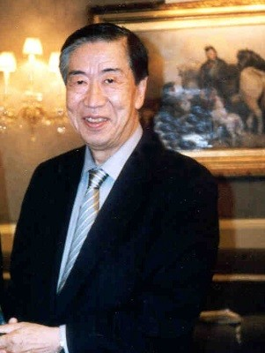
Introduction
Robust Design method, also called the Taguchi Method, pioneered by Dr. Genichi Taguchi, greatly improves engineering productivity.
Genichi Taguchi (1 January 1924 – 2 June 2012) was a statistician and engineer. He obtained his Ph.D. in Statistics and Mathematics Science at Kyushu University University, Japan in 1962.

Slide 5
Introduction
Genichi Taguchi Quotes:
“Cost is more important than quality but quality is the best way to reduce cost.”
“A scientific or technical study always consists of the following three steps: 1. One decides the objective. 2. One considers the method. 3. One evaluates the method in relation to the objective.”

Slide 6
Taguchi Method is quite different:
For examples, if seven variables can each be set at two levels, then the total number of experiments possible is given by Level of the power of factors, that is (2⁷) = 128.
It allows us to vary all the factors at a time and still let us evaluate the effect of each individual factor. Also, it allows us to do the limited number of experiments and then provides a method for predicting the other untried combinations.
For examples, in the cited example, Taguchi method suggests doing only 8 experiments to understand the 128 combinations.

Slide 7
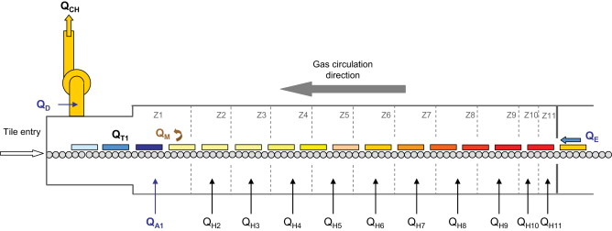

Taguchi Method is quite different:
A well-known example of Taguchi designs is from the Ina Tile Company of Japan in the 1950s. The company was manufacturing too many tiles outside specified dimensions.
A quality team discovered that the temperature in the kiln used to bake the tiles varied, causing nonuniform tile dimension. They could not eliminate the temperature variation because building a new kiln was too costly. Thus, temperature was a noise factor. Using Taguchi designed experiments, the team found that by increasing the clay's lime content, a control factor, the tiles became more resistant, or robust, to the temperature variation in the kiln, letting them manufacture more uniform tiles.

Slide 8
Taguchi Method is quite different:
In Taguchi designs, a measure of robustness used to identify control factors that reduce variability in a product or process by minimizing the effects of uncontrollable factors (noise factors).
In a Taguchi designed experiment, you manipulate noise factors to force variability to occur and from the results, identify optimal control factor settings that make the process or product robust, or resistant to variation from the noise factors.

Slide 9
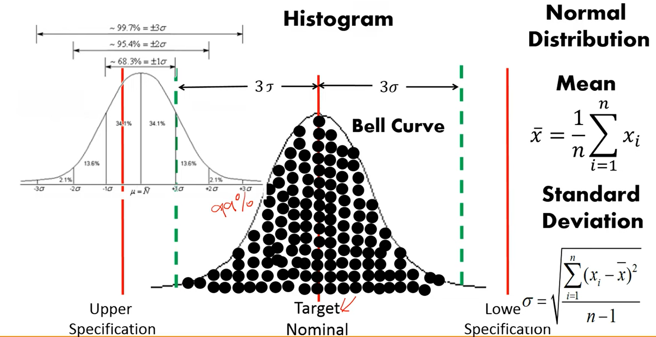
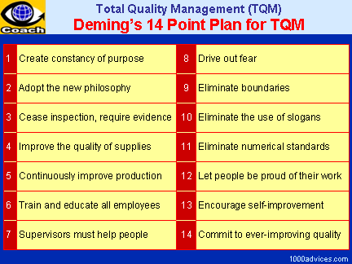
Background of the Taguchi Method
Robust Design method (or) Taguchi Method, pioneered by Dr. Genichi Taguchi, in 1980.
Comparable to importance to Statistical Process Control (SPC), the Deming approach and the Japanese concept of TQC.
TQM expresses about continuous improvement in the processes while QC is about maintaining the quality standards throughout the process.
QC is used to verify the quality of the output; TQM is the process of managing for quality.

Slide 10
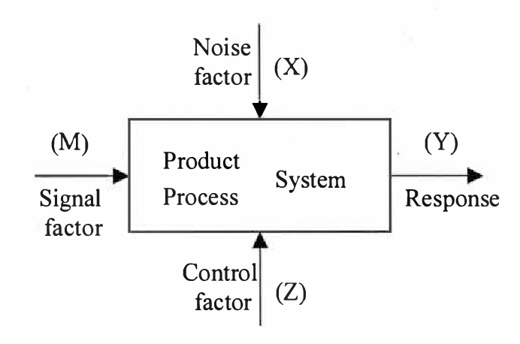
Taguchi Terminology
A schematic representation of a product / process is shown in a figure. The response is denoted by y and is called quality characteristics.

Slide 11
Taguchi Terminology
The parameters that influence the quality characteristic are classified as follows:
Signal factor (M): These are the parameters set by the user or operator of the product to express the intended value for the response of the product based on the knowledge of the product being developed. Sometimes 2 or more signal factors may also be used in combination to express the desired response.

Slide 12
Taguchi Terminology
Noise factor (x): Certain parameters are not controllable by the designer and are known as noise factors. Parameters whose settings (also called levels) are difficult to control in the field or whose levels are expensive to control are also considered noise factors. The levels of the noise factors change from one unit to another, from one environment to another, and from time to time. The noise factors cause the response y to deviate from the target specified by the signal factor M and lead to quality loss.
Control factor (z): These are parameters that can be specified by the designer. Control factor can take multiple values, called levels.

Slide 13
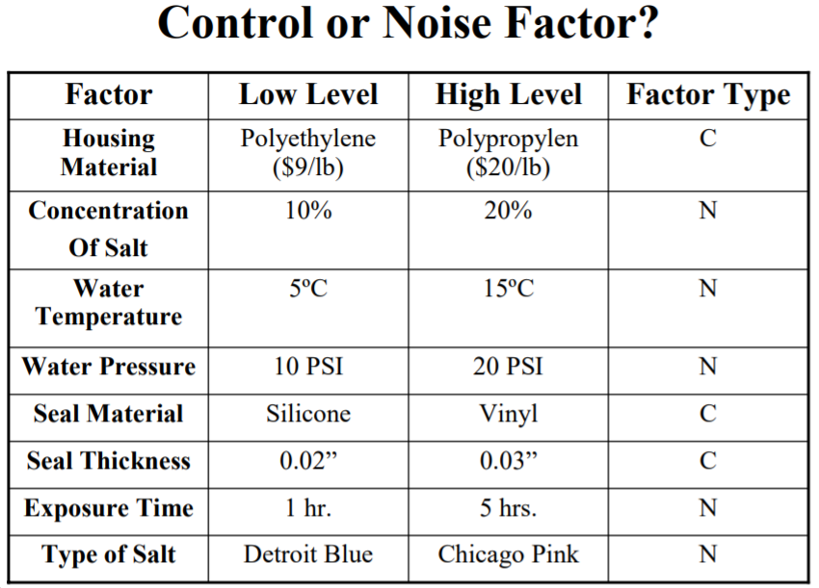
Control or Noise Factor (Example)
Most automotive sub-assemblies like the alternator, the ignition coil, and the electronic control module must undergo testing to determine if they are resistant to salt water that may be splashed on them from the road.
An automotive supplier is testing an ignition coil to determine if it will withstand salt water. The following factors are tested :

Slide 14
Background of the Taguchi Method
Unique aspects of the Taguchi Method
The Taguchi definition of quality
The concept of Robust Design
The Taguchi Quality Loss Function (QLF)

Slide 15
Background of the Taguchi Method
The Taguchi definition of quality
Ideal quality refers to a target value for determining the quality level
Ideal quality is delivered if a product or service tangible performs its intended function throughout its projected life under reasonable operating conditions without harmful side effects
Ideal quality is a function of customer perception and satisfaction
Service quality is measured in terms of loss to society

Slide 16
What is robust design?
2. The concept of Robust Design
Robust design is an “engineering methodology for improving productivity during research and development so that high-quality products can be produced.
Robust Design is a technique that reduces variation in a product by reducing the sensitivity of the design of the product to sources of variation rather than by controlling their sources. The end result is a robust design, a design that has minimum sensitivity to variations in uncontrollable factors

Slide 17
What is robust design?
What is Robust?
A system (product or process) is robust if it performs properly in a wide range of conditions.
Robust Products | Products that are not robust
A pen that writes until the ink is empty | Pen that stops writing after a few months
A car that starts at -20 deg | A car that does not start
A vacuum cleaner that maintains suction levels | A vacuum cleaner that loses suction
Notes:
https://www.youtube.com/watch?v=4ti8rfzh4xg

Slide 18
What is robust design?
What is Robust?
In the design of a new product, any design activity can be called robust, if it leads the product;
To have longer life (higher reliability)
To be more consistent with use
To be more consistent from product to product
To perform consistently as temperature and other conditions change
Notes:
https://www.youtube.com/watch?v=4ti8rfzh4xg

Slide 19
What is robust design?
Products and services should be designed to be inherently defect free and high quality
Meet customer’s expectations also under non-ideal conditions
Disturbances are events that cause the design performance to deviate from its target value
Taguchi divide disturbances into three categories
External disturbances: variation in the environment where the product is used
Internal disturbances: wear and tear inside a specific unit
Disturbances in the production process: deviation from target values

Slide 20
What is robust design?
A three step method for achieving robust design (Taguchi)
Concept design
Parameter design
Tolerance design
Concept Design / System Design
The process of examining competing technologies for producing a product – Includes choices of technology and process design.
A prototype design that can be produced and meets customers needs under ideal conditions without disturbances

Slide 21
What is robust design?
2. Parameter Design
The selection of control factors (parameters) and their optimal levels
The objective is to make the design Robust!
Control factors are those process variables in a process that management can influence
Ex. The procedures used and the type and amount of training
Often a complex (non-linear) relationship between the control factors and product / design performance
The optimal parameter levels can be determined through experimentation.

Slide 22
What is robust design?
3. Tolerance Design
Tolerance design deals with developing specification limits.
Necessary because there will always be some variation in the production process
Taguchi fiercely advocates aiming for the target value not just settle for inside the specification limits.
Tolerance design occurs after parameter design has been used to reduce variation and the resulting improvement has been insufficient.
Often results in increased production costs
More expensive input material might have to be used to meet specifications.
Interchangeability.

Slide 23
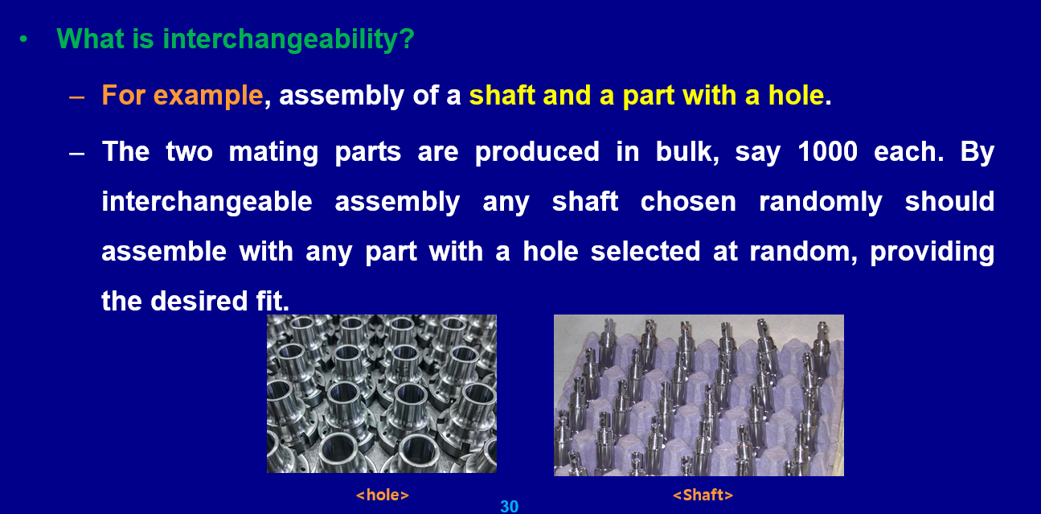
What is robust design?

Slide 24
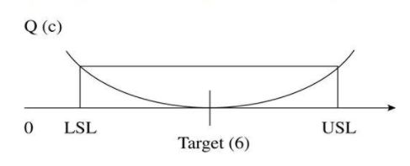
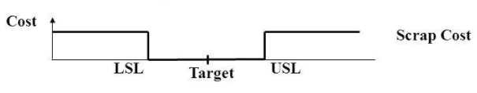
Background of the Taguchi Method
3. Taguchi Quality/Quadratic Loss Function (QLF)
Taguchi defines Quality as “the loss imparted to the society by the product from the time the product is designed to the time it is shipped to the customer”
LOSS = Cost to operate, Failure to function, maintenance and repair cost, customer satisfaction, poor design.
<Traditional approach>
<Taguchi approach>

Slide 25
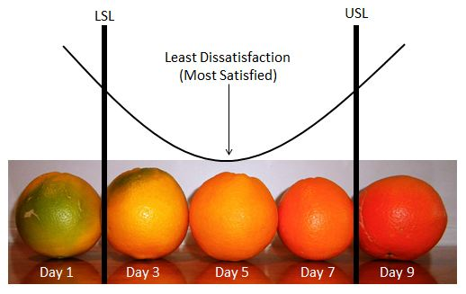
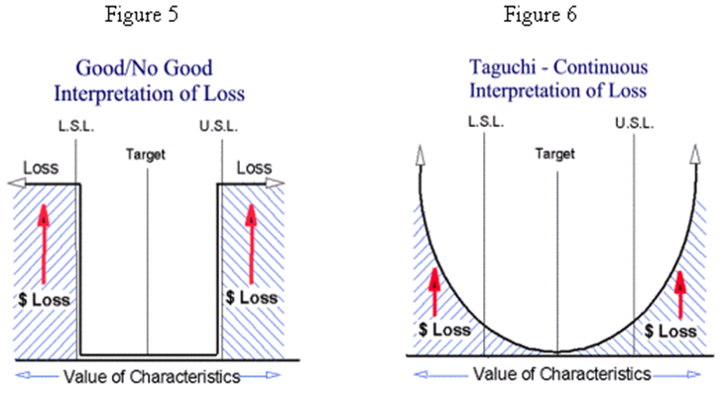
The Taguchi Quality/ Quadratic Loss Function (QLF)
<Taguchi approach>
<Traditional approach>
<Taguchi approach>

Slide 26
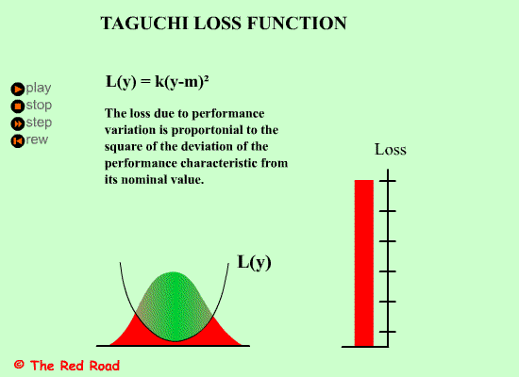
The Taguchi Quality/Quadratic Loss Function (QLF)
Where y is the critical performance parameter value,
L is the loss associated with a particular parameter y, m is the nominal value of the parameter specification (ie. Target value of y),
k is a constant that depends on the cost at the specification limits. (ie. Quality loss coefficient)

Slide 27
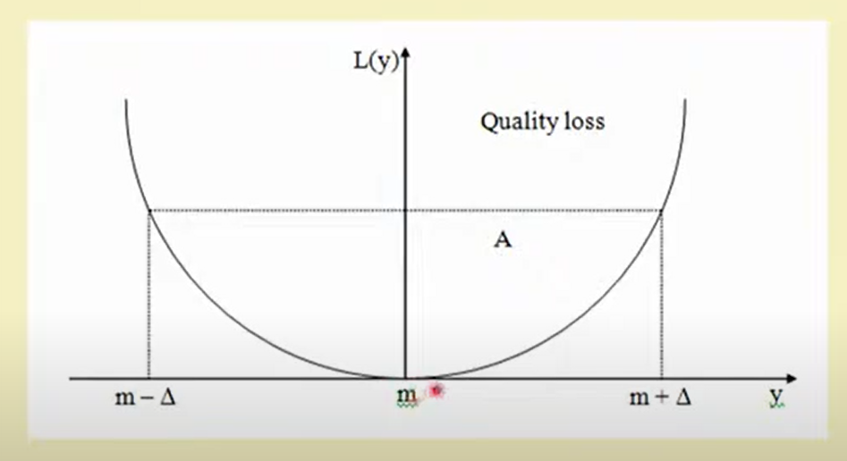
The Taguchi Quality Loss Function (QLF)

Slide 28
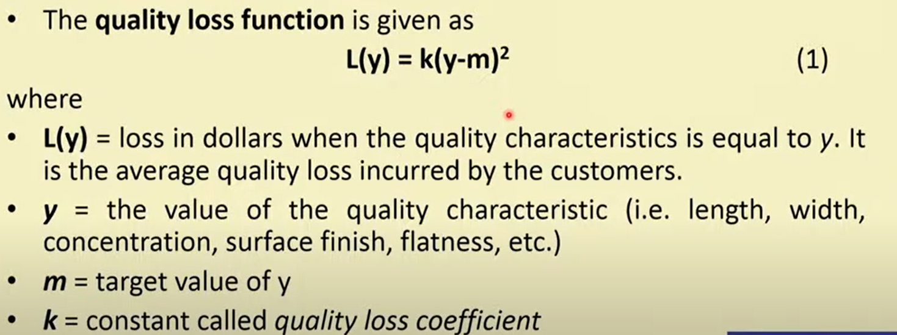
The Taguchi Quality Loss Function (QLF)
The loss is proportional to square of the deviation of y from the target value.
k is proportionality constant.

Slide 29
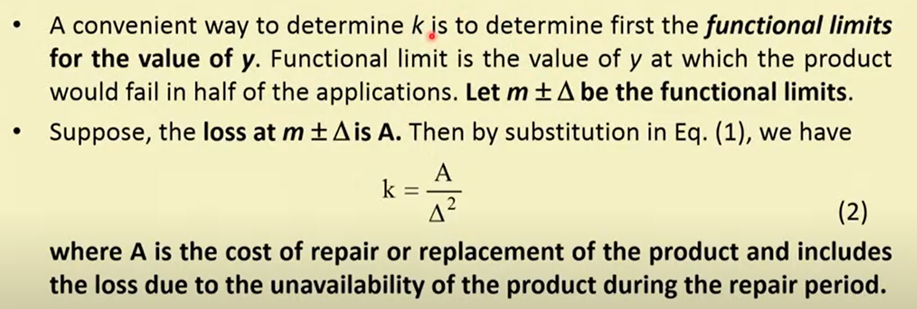
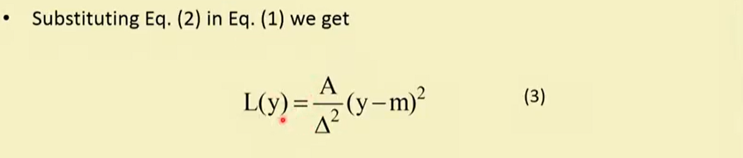
The Taguchi Quality Loss Function (QLF)
Notes:
https://www.youtube.com/channel/UCr6DCuvKavPIu1KwRCht7tg

Slide 30
Quality Evaluations
According to the traditional concept of loss function that as long as the product’s quality characteristics is within the specification limits or tolerances, there are no losses incurred. The lose takes the form of a step function with a constant value A outside of the specification limits or tolerances.
Taguchi defines quality as “the total loss imparted to society from the time the product is designed to the time product is shipped to the customer.”
Notes:
https://www.youtube.com/watch?v=ZS4vBrKMU5s

Slide 31
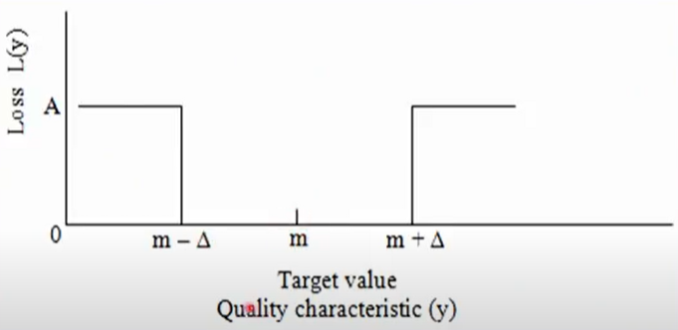
Quality Evaluations
Loss function L(y) makes no distinction between products
Whose quality characteristic is exactly on target at m, or
Whose quality characteristic is just above lower specification limit (LSL), or
Whose quality characteristics is just below the upper specification limit (USL)
Notes:
https://www.youtube.com/watch?v=ZS4vBrKMU5s

Slide 32
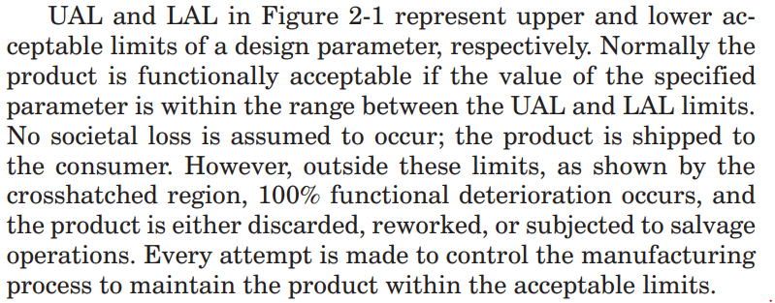
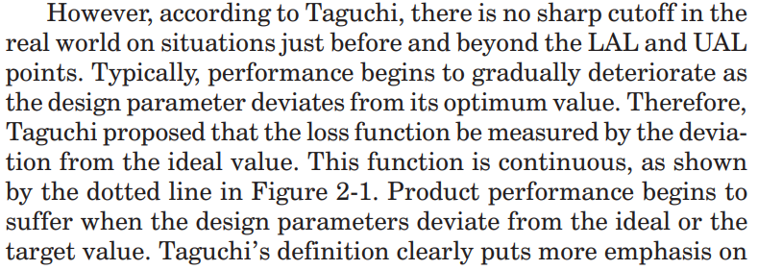
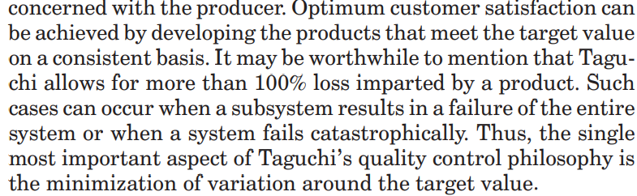
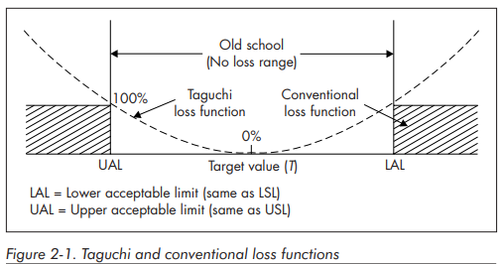
Quality Evaluations
The conventional method of computing the cost of quality is based on the number of parts rejected and reworked in a production environment. This method of quality evaluation is incapable of distinguishing between two samples, both within the specification limits but with different distributions of targeted properties.
Taguchi’s definition clearly puts more emphasis on customer satisfaction, whereas previously all definitions were concerned with the producer. Optimum customer satisfaction can be achieved by developing the products that meet the target value on a consistent basis.
https://brharnetc.edu.in/br/wp-content/uploads/2018/11/11.pdf
Notes:
https://www.youtube.com/watch?v=ZS4vBrKMU5s

Slide 33
Quality Evaluations
It is also doubtful that the loss function L(y) remains constant at a value of A beyond the specification limits USL and LSL.
Since the Taguchi loss function increases quadratically with increasing deviation from the target value, the Taguchi loss function can be applied to three different situations or cases, namely
Target is best (or) Nominal is best
Smaller is better
Larger is better
Notes:
https://www.youtube.com/watch?v=ZS4vBrKMU5s

Slide 34
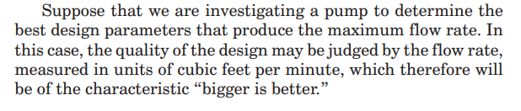
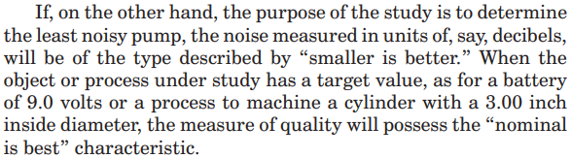
Quality Evaluations
Target is best (or) Nominal is best
Larger is better
Smaller is better
Ranjit K . Roy, A Primer on the Taguchi Method, Second

Slide 35
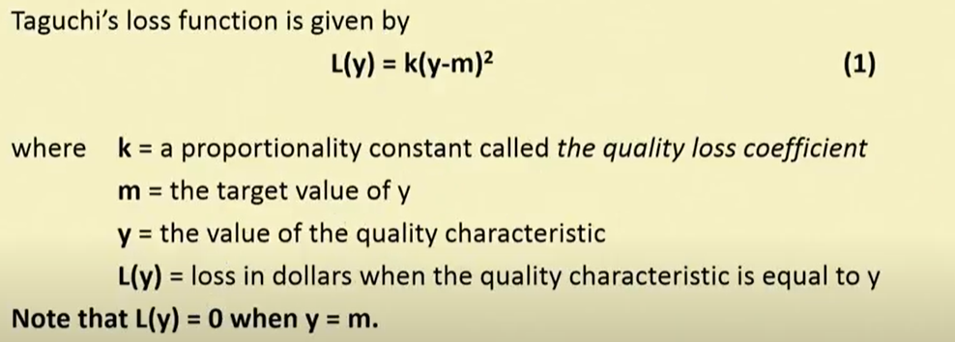
Quality Evaluations
Target is best or The Nominal-the-Best Case
Notes:
https://www.youtube.com/watch?v=ZS4vBrKMU5s

Slide 36
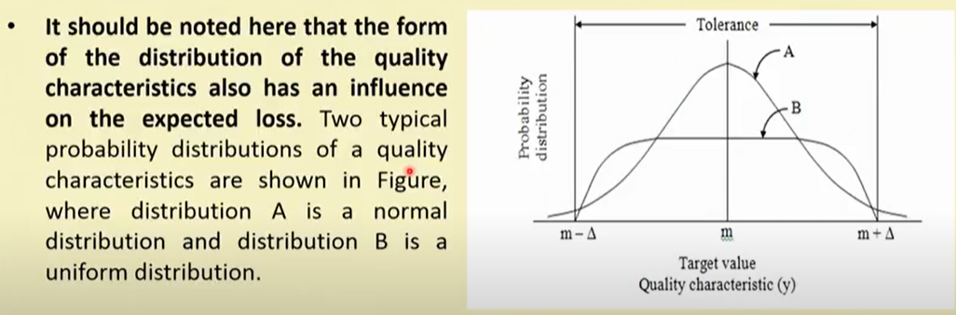
Quality Evaluations
Target is best or The Nominal-the-Best Case
Notes:
https://www.youtube.com/watch?v=ZS4vBrKMU5s

Slide 37
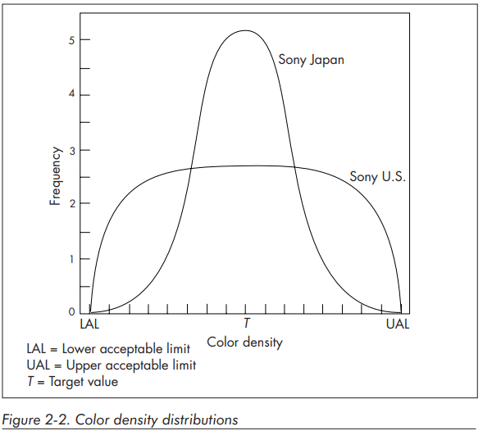
Quality Evaluations
Example Sony TV
https://brharnetc.edu.in/br/wp-content/uploads/2018/11/11.pdf
Notes:
https://www.youtube.com/watch?v=ZS4vBrKMU5s

Slide 38
Quality Evaluations (S/N Ratio)
Taguchi experiments often use a 2-step optimization process.
In step 1, use the signal-to-noise ratio to identify those control factors that reduce variability.
In step 2, identify control factors that move the mean to target and have a small or no effect on the signal-to-noise ratio.

Slide 39
Quality Evaluations (S/N Ratio)
Higher values of the signal-to-noise ratio (S/N) identify control factor settings that minimize the effects of the noise factors.
The signal-to-noise ratio measures how the response varies relative to the nominal or target value under different noise conditions. You can choose from different signal-to-noise ratios, depending on the goal of your experiment.
The important contribution of Taguchi is proposing the signal-to-noise (S/N) ratio. It was developed as a proactive equivalent to the reactive loss function.

Slide 40
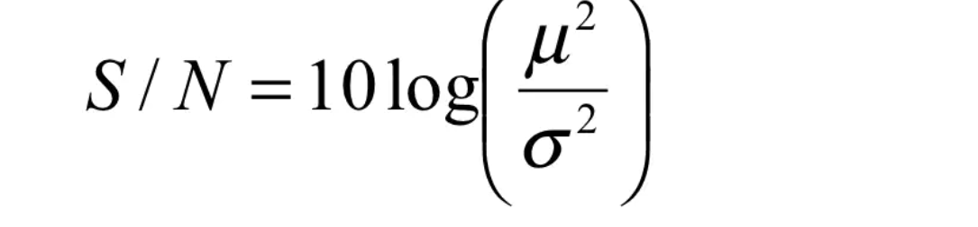
Quality Evaluations (S/N Ratio)
Mean
Standard Deviation or Variation
https://www.slideshare.net/rbalisnomo/Introduction-To-Taguchi-Method-05Sep08

Slide 41
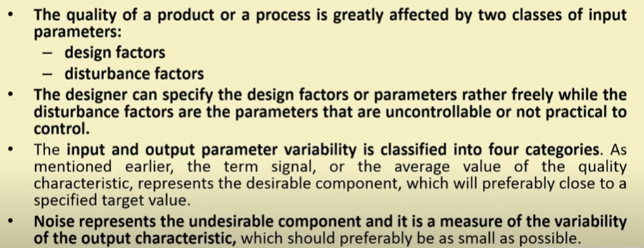
Signal-to-Noise Ratio

Slide 42
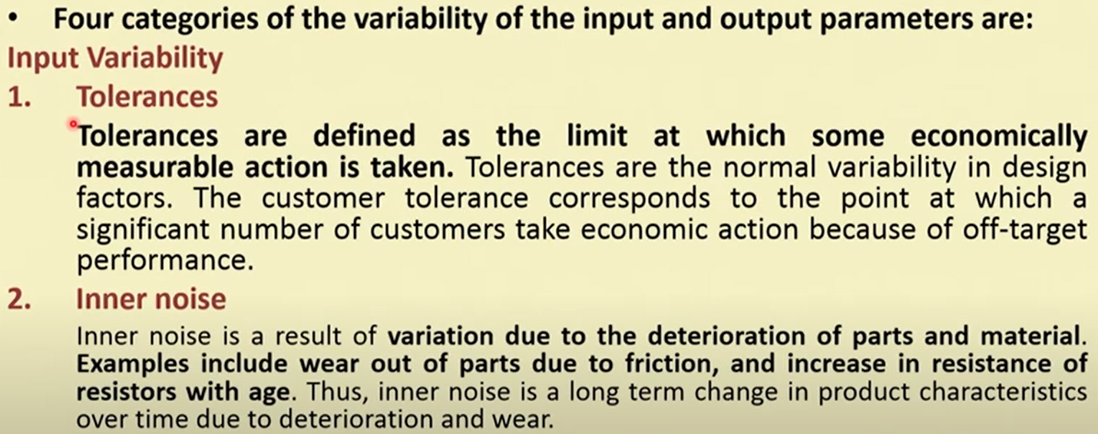
Signal-to-Noise Ratio

Slide 43
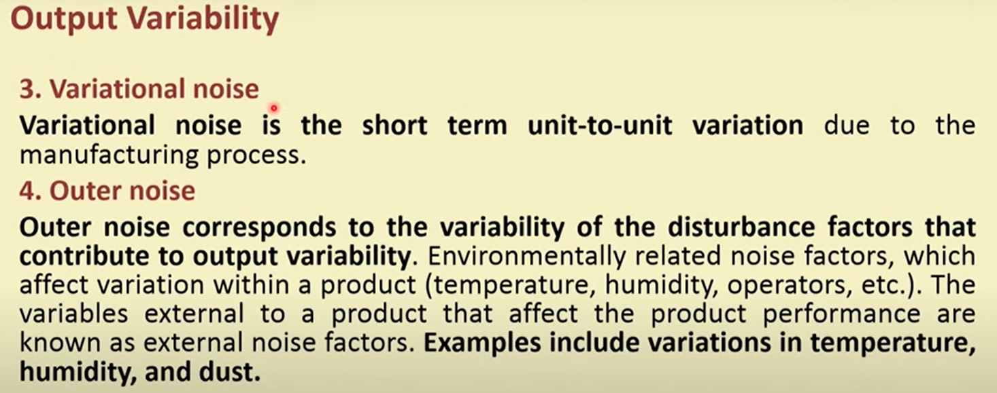
Signal-to-Noise Ratio

Slide 44
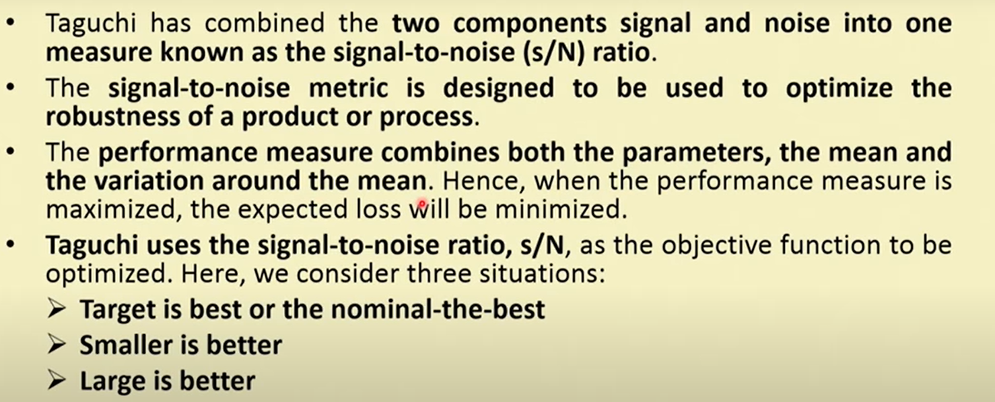
Signal-to-Noise Ratio

Slide 45
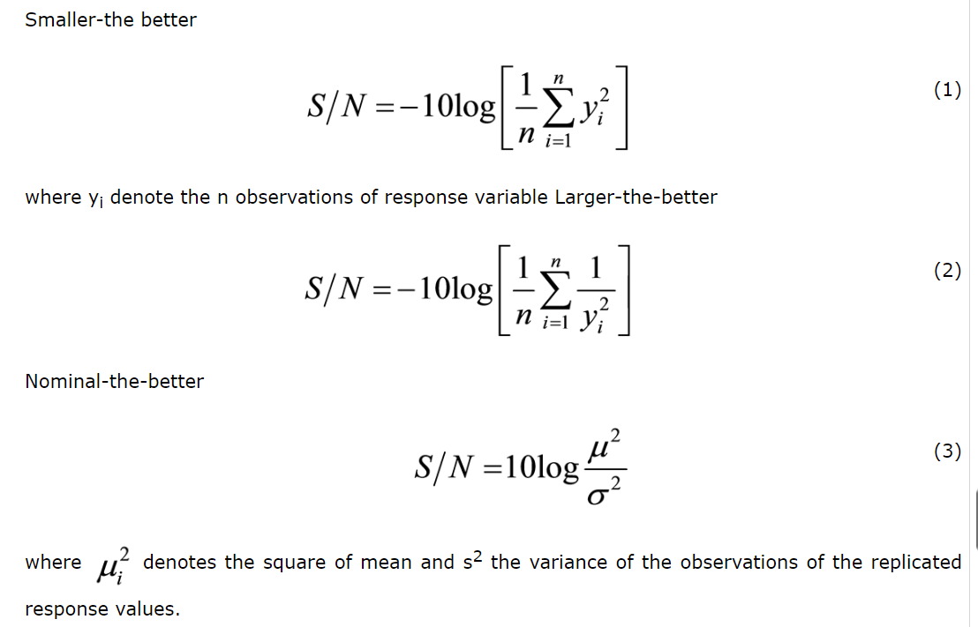
Signal-to-Noise Ratio

Slide 46
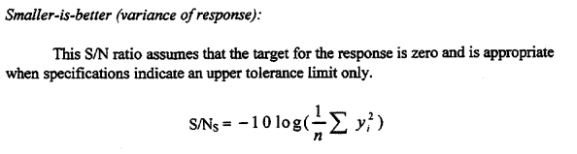
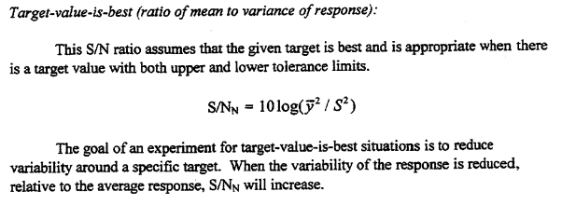
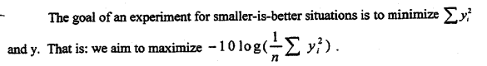
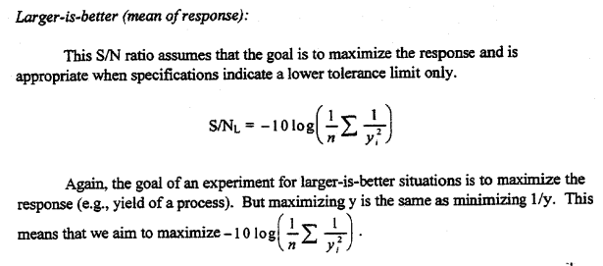
S/N Ratio

Slide 47

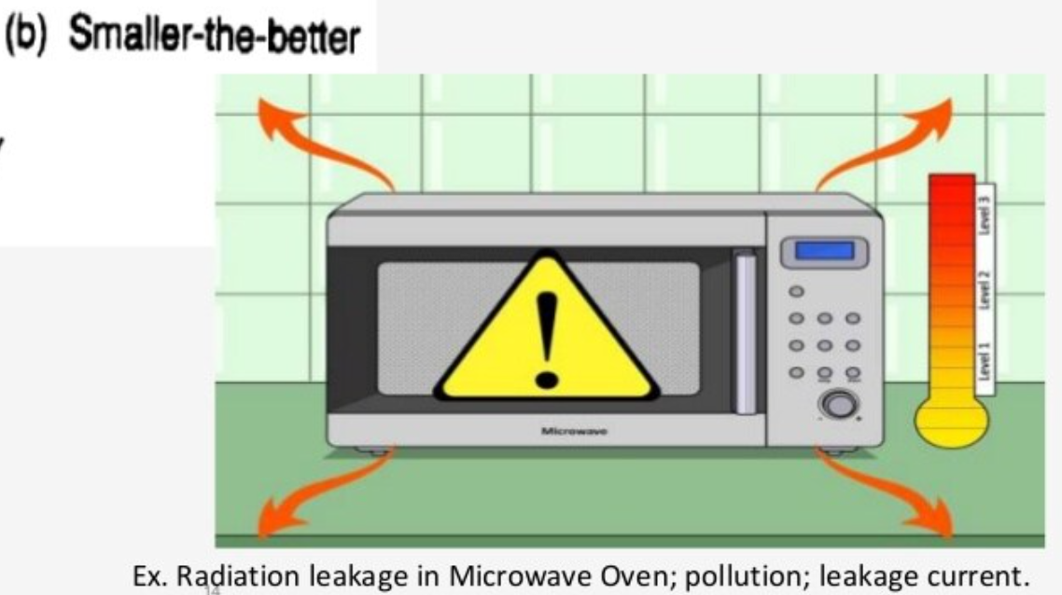

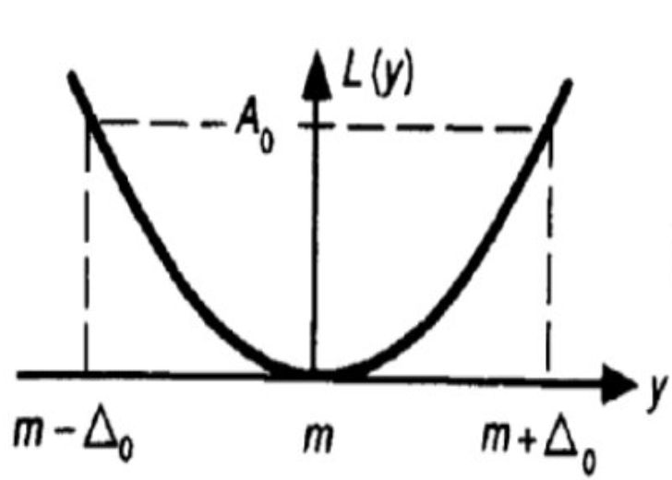
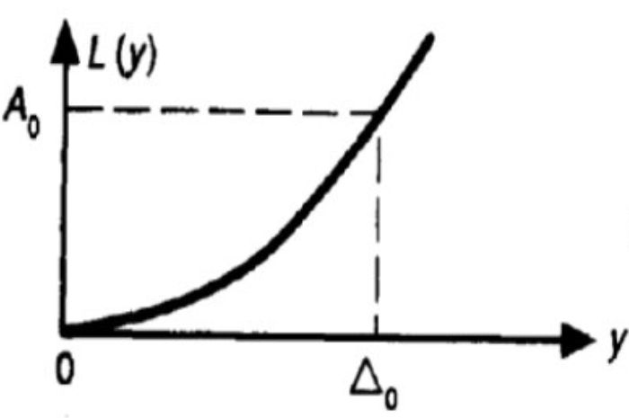
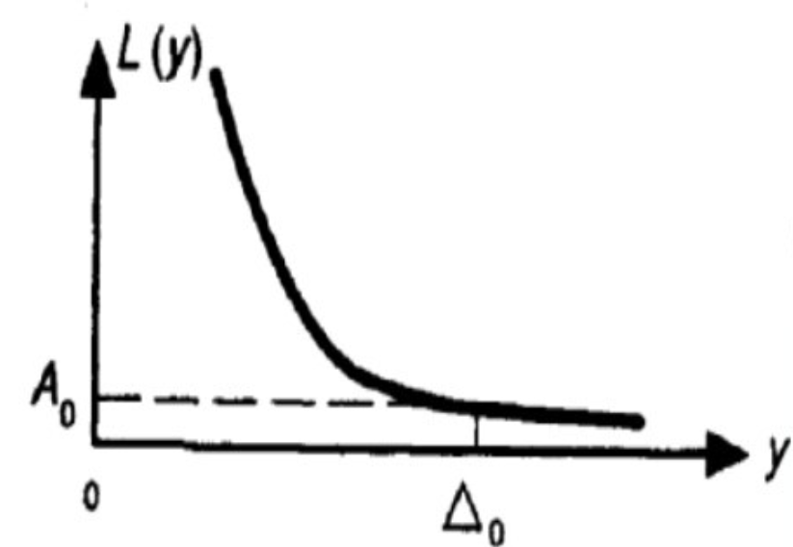
Taguchi Analysis (Example)
L(y) = k (y – m)²
L(y) = ky²
L(y) = k (1/y²)

Slide 48
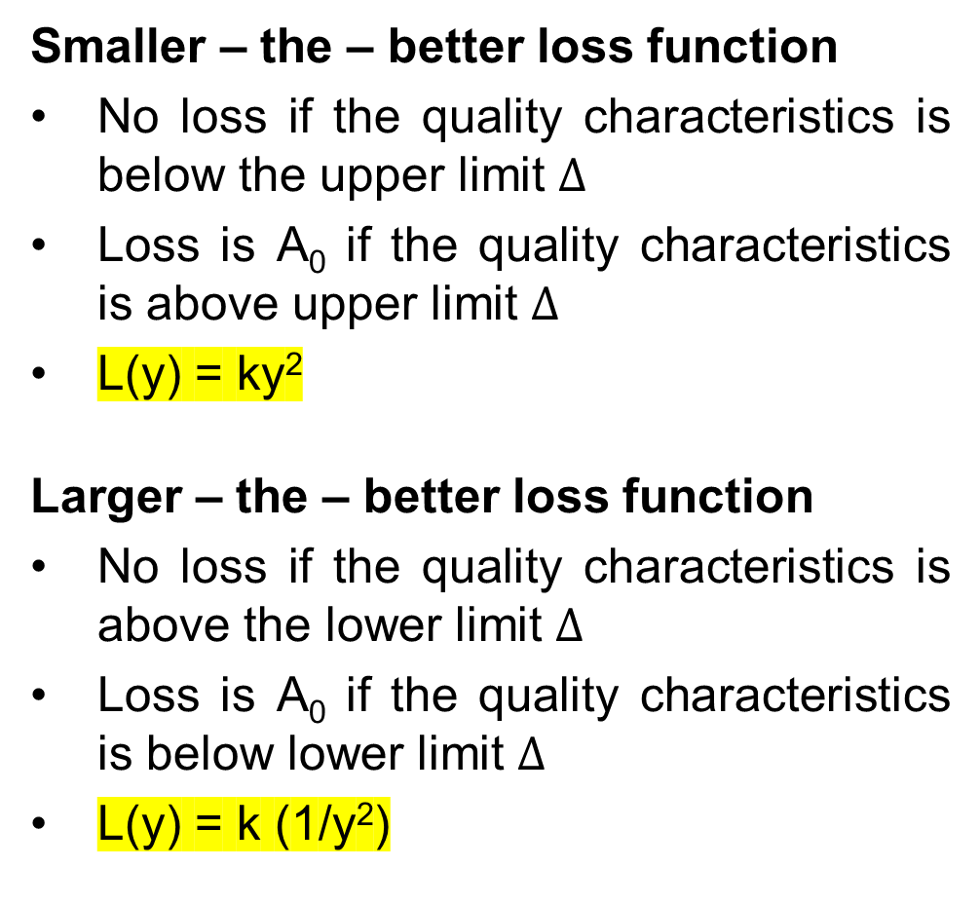
Quality Evaluations
Smaller – the – better loss function
No loss if the quality characteristics is below the upper limit $∆$
Loss is A₀ if the quality characteristics is above upper limit $∆$
L(y) = ky²
Larger – the – better loss function
No loss if the quality characteristics is above the lower limit $∆$
Loss is A₀ if the quality characteristics is below lower limit $∆$
L(y) = k (1/y²)
https://brharnetc.edu.in/br/wp-content/uploads/2018/11/11.pdf
Notes:
https://www.youtube.com/watch?v=ZS4vBrKMU5s

Slide 49
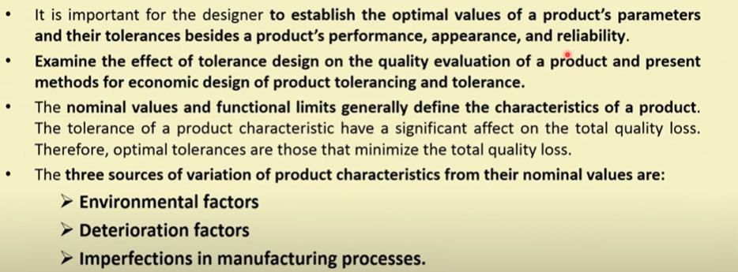
Tolerance Design and Tolerancing

Slide 50
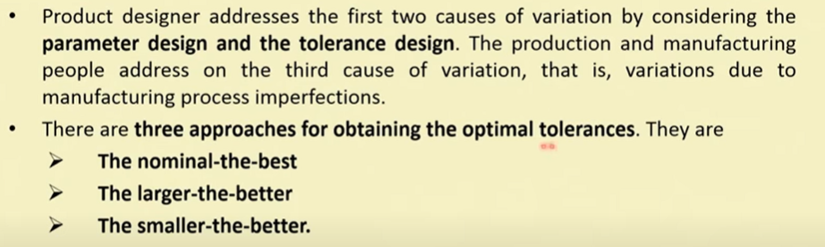
Tolerance Design and Tolerancing

Slide 51
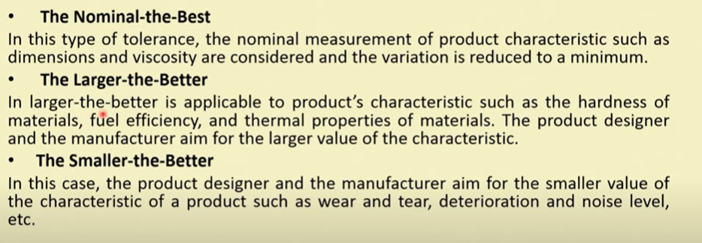
Tolerance Design and Tolerancing

Slide 52
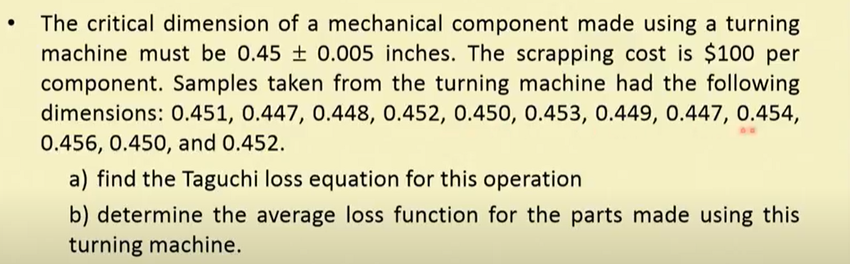
Example (Quality Loss Function)
Notes:
https://www.youtube.com/watch?v=ZS4vBrKMU5s

Slide 53
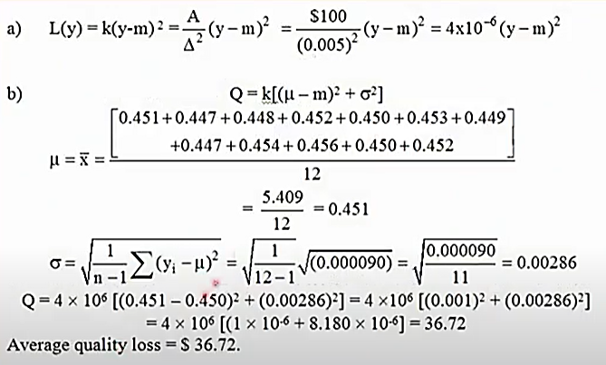
Example (Quality Loss Function)
Notes:
https://www.youtube.com/watch?v=ZS4vBrKMU5s

Slide 54
8-Steps in Taguchi Methodology
Choose control factors and their levels
Identify uncontrollable (noise) factors and decide on how they will be simulated.
Select the response variable(s) and determine the performance measures (mean, standard deviation, SNR, etc.)
Setup the experimental layout (choose appropriate design array (s))
Conduct the experiments and collect data
Analyze the data (effects, ANOVA, regression)
Choose optimal control factor levels and predict the performance measure at these levels
Confirm the optimal levels by experimentation.

Slide 55
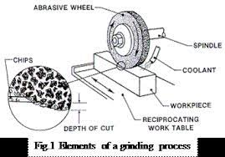
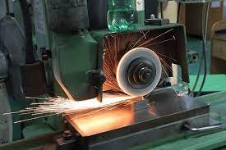
Taguchi Analysis (Example)
Improving the Grinding Ratio.
Imagine we are setting up an experiment in a grinding machine in our machine shop. We want to find out what settings in the grinding machine can give us maximum material removal efficiency, for a grinding wheel. We want to use Grinding ratio (GR) as the factor to be optimized.
GR is given by the expression material removed divided by wheel wear in grams.

Slide 56
Taguchi Analysis (Example)
Improving the Grinding Ratio.
Step 1: Problem definition: We want to maximize the GR by selecting suitable machine parameters for the given wheel formulation.
Step 2: Identify the Noise factor-i.e. Factors not in our control but are liable to affect the measured output (GR). Let us assume that all wheels of the same formulation may not work at the same efficiency level due to slight variations in processing. Let us also assume that different persons will experiment differently. This will also affect the results, but not in our control.

Slide 57
Taguchi Analysis (Example)
Improving the Grinding Ratio.
Step 3: Plan the evaluation method to take care of the noise factor:
To overcome the first noise factor, namely wheel inconsistency, we can arrange to test two wheels of the same category.
To overcome the second noise factor, namely operator difference, we can plan to have the wheels evaluated by two different operators.
The correct identification of noise factors and correct planning to capture these effects is the key to the success of this method. Thus in our case, for each selected machine settings, we have to get GR for 4 wheels of the same formulation (2 wheels by 1 operator and another 2 by the second operator).

Slide 58
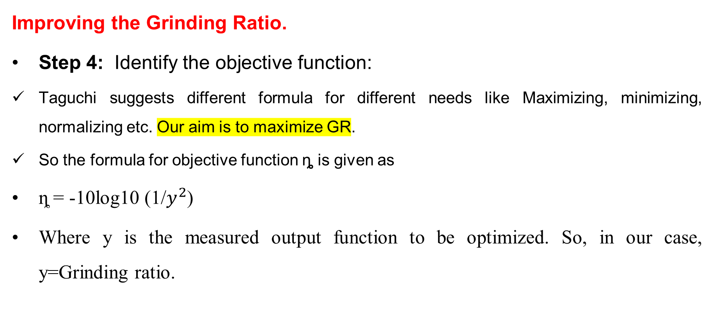
Taguchi Analysis (Example)
Improving the Grinding Ratio.
Step 4: Identify the objective function:
Taguchi suggests different formula for different needs like Maximizing, minimizing, normalizing etc. Our aim is to maximize GR.
So the formula for objective function ȵ is given as
ȵ = -10log10 (1/$y^{2}$)
Where y is the measured output function to be optimized. So, in our case, y=Grinding ratio.

Slide 59
Taguchi Analysis (Example)
Improving the Grinding Ratio.
Step 5: Identify control factors and their levels:
A control factor is one which has an effect on the output (Our case G.R) and which is controllable by us. A level indicates a setting.
Item | Control Factor | Level 1 | Level 2
A | Spindle speed | 33 mps | 45 mps
B | Feed rate | 2.5mm/rev | 5.0 mm / rev
C | Depth of cut | 0.5mm | 1.0mm

Slide 60
Taguchi Analysis (Example)
Improving the Grinding Ratio.
Step 6: Design of experiment
Taguchi method suggests the number of experiments to be used based on the number of factors. There are separate tables for two level and three level factors. The table giving the number of experiments is called Orthogonal array table.
For 2 Level factors
No of control factors | Array to be Selected
2-3 | L4
4-7 | L8
8-11 | L12
12-15 | L16
For 3 Level factors
No of control factors | Array to be Selected
2-4 | L9
5-7 | L18
From the above table, in our case, since there are three control factors of 2 level each, we choose orthogonal array L4, from the first table

Slide 61
Taguchi Analysis (Example)
Improving the Grinding Ratio.
Step 6: Design of experiment
L4 looks as below. (Taguchi method lists such table for all Orthogonal arrays).
Expt. No | Spindle speed mps | Feed rate mm/rev | Depth of cut mm
1 | 33 | 2.5 | 0.5
2 | 33 | 5.0 | 1.0
3 | 45 | 2.5 | 1.0
4 | 45 | 5.0 | 0.5
Expt.No | L4 orthogonal Array
 | Control Factor levels
 | A | B | C
1 | 1 | 1 | 1
2 | 1 | 2 | 2
3 | 2 | 1 | 2
4 | 2 | 2 | 1
The number of experiments at each setting is decided by us from steps 2 &3 to capture the noise factors. Please note that this is different from the number of machine settings as given in orthogonal array.

Slide 62
Taguchi Analysis (Example)
Improving the Grinding Ratio.
Step 6: Design of experiment
In our case, since we have assumed 2 operators evaluating two wheels each , we will be doing experiments in 4 different settings with 4 repetitions for each setting.

Slide 63
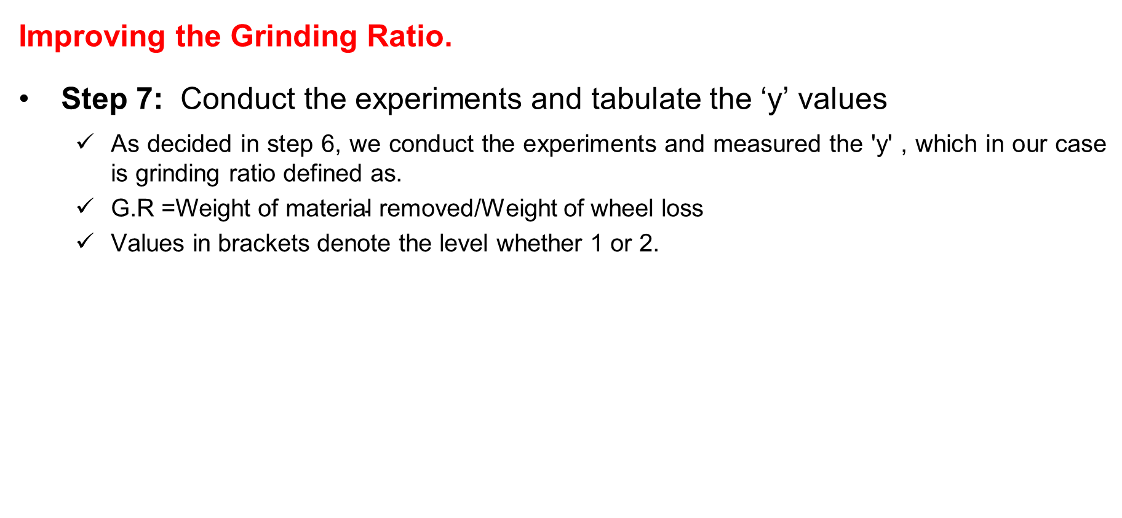
Taguchi Analysis (Example)
Improving the Grinding Ratio.
Step 7: Conduct the experiments and tabulate the ‘y’ values
As decided in step 6, we conduct the experiments and measured the 'y' , which in our case is grinding ratio defined as.
G.R =$\text{Weight} \text{of} \text{material} \text{removed}$/Weight of wheel loss
Values in brackets denote the level whether 1 or 2.
Expt. No | Speed | Feed rate | Depth of cut | Measured values of 'y' G.R
 |  |  |  | 1 | 2 | 3 | 4
1 | 33(1) | 2.5(1) | 0.5(1) | 21.5 | 20.2 | 20.5 | 19.0
2 | 33(1) | 5.0 (2) | 1.0 (2) | 18.5 | 17.5 | 18.0 | 18.0
3 | 45(2) | 2.5 (1) | 1.0 (2) | 19.0 | 19.5 | 18.8 | 18.8
4 | 45(2) | 5.0 (2) | 0.5 (1) | 16.0 | 16.2 | 16.6 | 16.6

Slide 64

Taguchi Analysis (Example)
Improving the Grinding Ratio.
Step 8: Calculate the objective function
From step 4, for our type of problem of larger the better category
η = - 10 log10 {1/4 (1/${21.5}^{2}$+ 1/${20.2}^{2}$+ 1/${20.5}^{2}$+ 1/${19}^{2}$) } = 26.13

Slide 65
Taguchi Analysis (Example)
Improving the Grinding Ratio.
Step 8: Calculate the objective function
Expt. No | Speed | Feed rate | Depth of cut | Measured values of 'y' G.R |  |  |  | η
 |  |  |  | 1 | 2 | 3 | 4
1 | 33(1) | 2.5(1) | 0.5(1) | 21.5 | 20.2 | 20.5 | 19.0 | 26.13
2 | 33(1) | 5.0 (2) | 1.0 (2) | 18.5 | 17.5 | 18.0 | 18.0 | 25.10
3 | 45(2) | 2.5 (1) | 1.0 (2) | 19.0 | 19.5 | 18.8 | 18.8 | 25.58
4 | 45(2) | 5.0 (2) | 0.5 (1) | 16.0 | 16.2 | 16.6 | 16.6 | 24.27
 |  |  |  | Mean |  |  |  | 25.27

Slide 66
Taguchi Analysis (Example)
Improving the Grinding Ratio.
Step 9: Determine the factor effects
This method helps in segregating the individual effect of each control factor at each level and is denoted as mA1 mB1 etc. mA1 means the effect of factor A at level 1 mC2 means the effect of factor C at level 2 Let us see how this can be calculated From the table under step 7. mA1 should be the effect of all those η values where factor A (speed) is used in level 1 (33mps). This occurs in expt.1 and expt. 2. So, using the values of these experiments,
mA1 =1/2 (η1 + η2) = 0.5 (26.13 +25.10) = 25.62

Slide 67
Taguchi Analysis (Example)
Expt.No | L4 orthogonal Array
 | Control Factor levels
 | A | B | C
1 | 1 | 1 | 1
2 | 1 | 2 | 2
3 | 2 | 1 | 2
4 | 2 | 2 | 1
Improving the Grinding Ratio.
Step 9: Determine the factor effects
Similarly, we can calculate the effect of other factors also as below:
mA₁ =1/2 (η₁ + η₂) = 0.5 (26.13 +25.10) = 25.62
mA₂ =1/2 (η₃ + η₄) = 0.5 (25.58 +24.27) = 24.92
mB₁ =1/2 (η₁ + η₃) = 0.5 (26.13 +25.58) = 25.86
mB₂ =1/2 (η₂ + η₄) = 0.5 (25.10 +24.27) = 24.68
mC₁ =1/2 (η₁ + η₄) = 0.5 (26.13 +24.27) = 25.2
mC₂ =1/2 (η₂ + η₃) = 0.5 (25.10 +25.58) = 25.34
Factor | Level
 | 1 | 2
A (speed) | 25.62 | 24.92
B (Feed rate) | 25.86 | 24.68
C (depth of cut) | 25.2 | 25.34
These are tabulated and plotted with control factors at three individual points along x axis.

Slide 68
Taguchi Analysis (Example)
Improving the Grinding Ratio.
From the graph, level 1 of A, level 1 of B and level 2 of C give the maximum effect in improving G.R.

Slide 70
Taguchi Analysis (Example)
Improving the Grinding Ratio.
Step 9: Determine the factor effects
Naturally, Al, B1, C2 is the best combination. i.e. a speed of 33mps , a feed rate of 2.5m/min and a depth of cut of 1mm will give the maximum G.R.
It is of interest to see that we have not tried this combination. The combinations tried by us are given below:
Expt 1 was Al, B1, C1
Expt 2 was A1, B2, C2
Expt 3 was A2, B1, C2
Expt 4 was A2, B2, C1
Other inferences from the graph Factor B has the largest effect on GR; Factor C has the least effect on GR. The lowest GR is from A2, B2, C1.

Slide 71

Taguchi Analysis (Example)
Improving the Grinding Ratio.
Step 10: Predicting GR for Untried combinations
This is the most exciting part of Taguchi method. Any combination of control factor settings, even for experiments not conducted, can be estimated, using the formula.
η = µ + (mA - µ) + (mB - µ) + (mC - µ)
where µ = mean
for example, for the combination of A2 B2 C1.
η = µ + (m$A_{2}$- µ) + (m$B_{2}$- µ) + (m$C_{1}$- µ)
= 25.27 + (24.92 - 25.27) + (24.68 – 25.27) + (25.20 - 25.27)
= 24.26
Which is very close to 24.27 in the table under step 7 for expt 4.
Factor | Level
 | 1 | 2
A (speed) | 25.62 | 24.92
B (Feed rate) | 25.86 | 24.68
C (depth of cut) | 25.2 | 25.34

Slide 72


Taguchi Analysis (Example)
Already did on the following combination
Improving the Grinding Ratio.
Step 10: Predicting GR for Untried combinations
So, for the expected combination of A1 B1 C2 ,
η expectable = µ + (mA1 - µ) + (mB1 - µ) + (mC2 - µ)
= 25.27 + (25.62 - 25.27) + (25.86 – 25.27) + (25.34 - 25.27)
= 26.28
From our definition, η = -10 log10 ( 1 / $y^{2}$) = 26.28
log10 ( 1 / $y^{2}$) = 26.28/(-10)
log10 ( 1 / $y^{2}$) = -2.628
(1 / $y^{2}$) = antilog ( -2.628 )
(1 / $y^{2}$) = 10^(-2.628)
(1 / $y^{2}$) = 0.002355
($y^{2}$) = 1/(0.002355) = 424.6196
So, y = SQRT (424.6196) = 20.61 GR max.
Factor | Level
 | 1 | 2
A (speed) | 25.62 | 24.92
B (Feed rate) | 25.86 | 24.68
C (depth of cut) | 25.2 | 25.34

Slide 73

Taguchi Analysis (Example)
Instead of 8 combinations, we tried only four combinations of setting and from these four we were able to predict the GR achievable for those combinations of controls which we have not tried.
For 3 — two level factors, the combinations possible are only $2^{3}$= 8. Here we tried 4 experiments.
But suppose there are seven factors like speed, infeed, dressing traverse etc. each with three setting levels, then the possibility is $3^{7}$ = 2187 combinations.
The effect of all these 2187 experiments can be predicted with just 18 experiments. (for 3 level factors of 7 numbers, we use L18 array).

Slide 74
Taguchi Analysis (Orthogonal Array)
For 2 Level factors
No of control factors | Array to be Selected
2-3 | L4
4-7 | L8
8-11 | L12
12-15 | L16
For 3 Level factors
No of control factors | Array to be Selected
2-4 | L9
5-7 | L18
Expt.No | L4 orthogonal Array
 | Control Factor levels
 | A | B | C
1 | 1 | 1 | 1
2 | 1 | 2 | 2
3 | 2 | 1 | 2
4 | 2 | 2 | 1

Slide 75
Taguchi Analysis (Orthogonal Array)
L8 (2^7) ORTHOGONAL ARRAY
Expt. No | Columns
 | 1 | 2 | 3 | 4 | 5 | 6 | 7
1 | 1 | 1 | 1 | 1 | 1 | 1 | 1
2 | 1 | 1 | 1 | 2 | 2 | 2 | 2
3 | 1 | 2 | 2 | 1 | 1 | 2 | 2
4 | 1 | 2 | 2 | 2 | 2 | 1 | 1
5 | 2 | 1 | 2 | 1 | 2 | 1 | 2
6 | 2 | 1 | 2 | 2 | 1 | 2 | 1
7 | 2 | 2 | 1 | 1 | 2 | 2 | 1
8 | 2 | 2 | 1 | 2 | 1 | 1 | 2
L9 (3^4) ORTHOGONAL ARRAY
Expt.No | Columns
 | 1 | 2 | 3 | 4
1 | 1 | 1 | 1 | 1
2 | 1 | 2 | 2 | 2
3 | 1 | 3 | 3 | 3
4 | 2 | 1 | 2 | 3
5 | 2 | 2 | 3 | 1
6 | 2 | 3 | 1 | 2
7 | 3 | 1 | 3 | 2
8 | 3 | 2 | 1 | 3
9 | 3 | 3 | 2 | 1

Slide 76

Taguchi Analysis (Orthogonal Array)

Slide 77

Taguchi Analysis (Example Problem)
The objective of the experiment is to obtain minimum surface roughness of the parts machined by wire cut EDM machine using Taguchi’s DOE technique of process parameters.
Surface roughness(Ra) values were obtained using Taylor-Hobson Surtronic instruments and the sequence are 2.5275, 2.3520, 2.2540, 2.4650, 2.7000, 2.8125, 2.350, 2.2875.
Find out the Main effect and draw the factor effect diagram and identify the optimum WEDM process parameters.

Slide 78
Taguchi Analysis (Example Problem)
Since, the number of factors given are 7 with 2 levels. Hence, we can choose L8 orthogonal array.
Expt. No | Columns
 | 1 | 2 | 3 | 4 | 5 | 6 | 7
1 | 1 | 1 | 1 | 1 | 1 | 1 | 1
2 | 1 | 1 | 1 | 2 | 2 | 2 | 2
3 | 1 | 2 | 2 | 1 | 1 | 2 | 2
4 | 1 | 2 | 2 | 2 | 2 | 1 | 1
5 | 2 | 1 | 2 | 1 | 2 | 1 | 2
6 | 2 | 1 | 2 | 2 | 1 | 2 | 1
7 | 2 | 2 | 1 | 1 | 2 | 2 | 1
8 | 2 | 2 | 1 | 2 | 1 | 1 | 2

Slide 79

Taguchi Analysis (Example Problem)
L8 orthogonal array.
Smaller-the-Better: η = -10 log10( $y^{2}$)
Hence solving for η
Expt. No | Columns |  |  |  |  |  |  | Surface Roughness (y) | η
 | Pull on Timet (A) | Pulse off time (B) | Peak Current(C) | Wire Tension (D) | Wire Feed (E) | Fluid Rate (F) | Fluid Pressure (G)
1 | 125 (1) | 35 (1) | 11 (1) | 1000 (1) | 7 (1) | 8 (1) | 13 (1) | 2.5275 |  | η1
2 | 125 (1) | 35 (1) | 11 (1) | 1200 (2) | 8 (2) | 9 (2) | 15 (2) | 2.3520 |  | η2
3 | 125 (1) | 40 (2) | 12 (2) | 1000 (1) | 7 (1) | 9 (2) | 15 (2) | 2.2540 |  | η3
4 | 125 (1) | 40 (2) | 12 (2) | 1200 (2) | 8 (2) | 8 (1) | 13 (1) | 2.4650 |  | η4
5 | 130 (2) | 35 (1) | 12 (2) | 1000 (1) | 8 (2) | 8 (1) | 15 (2) | 2.7000 |  | η5
6 | 130 (2) | 35 (1) | 12 (2) | 1200 (2) | 7 (1) | 9 (2) | 13 (1) | 2.8125 |  | η6
7 | 130 (2) | 40 (2) | 11 (1) | 1000 (1) | 8 (2) | 9 (2) | 13 (1) | 2.350 |  | η7
8 | 130 (2) | 40 (2) | 11 (1) | 1200 (2) | 7 (1) | 8 (1) | 15 (2) | 2.2875 |  | η8
 |  |  |  |  |  |  |  | µ

Slide 80
Taguchi Analysis (Example Problem)
L8 orthogonal array.
Smaller-the-Better: η = -10 log10( $y^{2}$)
Hence solving for η
Expt. No | Columns |  |  |  |  |  |  | Surface Roughness (y) | η
 | Peak current (A) | Pulse on time (B) | Peak Current(C) | Wire Tension (D) | Wire Feed (E) | Fluid Rate (F) | Fluid Pressure (G)
1 | 125 (1) | 35 (1) | 11 (1) | 1000 (1) | 7 (1) | 8 (1) | 13 (1) | 2.5275 | -8.053823285 | η1
2 | 125 (1) | 35 (1) | 11 (1) | 1200 (2) | 8 (2) | 9 (2) | 15 (2) | 2.3520 | -7.428746348 | η2
3 | 125 (1) | 40 (2) | 12 (2) | 1000 (1) | 7 (1) | 9 (2) | 15 (2) | 2.2540 | -7.059078234 | η3
4 | 125 (1) | 40 (2) | 12 (2) | 1200 (2) | 8 (2) | 8 (1) | 13 (1) | 2.4650 | -7.836338472 | η4
5 | 130 (2) | 35 (1) | 12 (2) | 1000 (1) | 8 (2) | 8 (1) | 15 (2) | 2.7000 | -8.627275283 | η5
6 | 130 (2) | 35 (1) | 12 (2) | 1200 (2) | 7 (1) | 9 (2) | 13 (1) | 2.8125 | -8.981850622 | η6
7 | 130 (2) | 40 (2) | 11 (1) | 1000 (1) | 8 (2) | 9 (2) | 13 (1) | 2.350 | -7.421357245 | η7
8 | 130 (2) | 40 (2) | 11 (1) | 1200 (2) | 7 (1) | 8 (1) | 15 (2) | 2.2875 | -7.187222055 | η8
 |  |  |  |  |  |  |  | µ | -7.82446144

Slide 81
Taguchi Analysis (Example Problem)
Determine the factor effects
mA₁ =1/4 (η₁ + η₂ + η₃ + η₄) = 0.25 * (-8.053-7.428-7.059-7.836) = -7.5945
…
…
…
…
…
…
…
…
…
….

Slide 82
Taguchi Analysis (Example Problem)
Determine the factor effects
mA₁ =1/4 (η₁ + η₂ + η₃ + η₄) = 0.25 * (-8.053-7.428-7.059-7.836) = -7.5945
mA₂ =1/4 (η₅ + η₆ + η₇ + η₈) = 0.25 * (-8.627-8.981-7.42-7.187) = -8.053
mB₁ =1/4 (η₁ + η₂ + η₅ + η₆) =
mB₂ =1/4 (η₃ + η₄ + η₇ + η₈) =
mC₁ =
mC₂ =
mD₁ =
mD₂ =
mE₁ =
mE₂ =
mF₁ =
mF₂ =
mG₁ =
mG₂ =

Slide 83

Taguchi Analysis (Example Problem)
Determine the factor effects
mA₁ =1/4 (η₁ + η₂ + η₃ + η₄) = 0.25 * (-8.053-7.428-7.059-7.836) = -7.5945
mA₂ =1/4 (η₅ + η₆ + η₇ + η₈) = 0.25 * (-8.627-8.981-7.42-7.187) = -8.053
mB₁ =1/4 (η₁ + η₂ + η₅ + η₆) = -8.272
mB₂ =1/4 (η₃ + η₄ + η₇ + η₈) = -7.37
mC₁ =1/4 (η₁ + η₂ + η₇ + η₈) = -7.522
mC₂ =1/4 (η₃ + η₄ + η₅ + η₆) = -8.125
mD₁ =1/4 (η₁ + η₃ + η₅ + η₇) = -7.789
mD₂ =1/4 (η₂ + η₄ + η₆ + η₈) = -7.858
mE₁ =1/4 (η₁ + η₃ + η₆ + η₈) = -7.82
mE₂ =1/4 (η₂ + η₄ + η₅ + η₇) = -7.827
mF₁ =1/4 (η₁ + η₄ + η₅ + η₈) = -7.925
mF₂ =1/4 (η₂ + η₃ + η₆ + η₇) = -7.722
mG₁ =1/4 (η₁ + η₄ + η₆ + η₇) = -8.072
mG₂ =1/4 (η₂ + η₃ + η₅ + η₈) = -7.575

Slide 84


Taguchi Analysis (Example Problem)
Determine the factor effects (graph)

Slide 85


Taguchi Analysis (Example Problem)
Determine the factor effects (graph)

Slide 86


Taguchi Analysis (Example Problem)
Determine the factor effects (graph)

Slide 87

Taguchi Analysis (Example Problem)
Determine the factor effects (graph)

Slide 88

Taguchi Analysis (Example Problem)
A1, B2, C1, D1, E2, F2, G2 giving the minimum effect in reducing the surface roughness.
η = µ + (mA1 - µ) + (mB2 - µ) + (mC1 - µ) + (mD1 - µ) + (mE2 - µ) + (mF2 - µ) + (mG2 - µ)
= -7.823 + (-7.594+7.823) + (-7.37+7.823) + (-7.597+7.823) + (-7.789+7.823) + (-7.827+7.823) + (-7.722+7.823) + (-7.573+7.823)
= -6.533
η = -6.533
i.e., η = -10 log10( $y^{2}$) = -6.533
log10( $y^{2}$) = 0.6533
$y^{2}$ = antilog (0.6533)
$y^{2}$ = 4.5009
$y$ = 2.12
Hence, Surface Roughness = 2.12 with the above combination.

Slide 89

Taguchi Analysis (Example Problem)
Problem: The objective of the research is an experimental investigation to find optimization of machining parameters of EDM machine for machining steel material EN-8 using Taguchi’s DOE.
Ra values obtained according to experiment sequence are 2.625, 1.905,2.5275,2.99,4.4325,4.10,3.38,3.015, 3.312.
Find out the Main effect and draw the factor effect diagram and identify the optimum process parameters.

Slide 90
Taguchi Analysis (Example Problem)
Solution:
How many factors ?
How many levels ?
Which Orthogonal Array?

Slide 91
Taguchi Analysis (Example Problem)
Solution: Hence, 4 factors and 3 levels, we have to choose L9 orthogonal array.
L9 (3^4) ORTHOGONAL ARRAY
Expt.No | Columns
 | 1 | 2 | 3 | 4
1 | 1 | 1 | 1 | 1
2 | 1 | 2 | 2 | 2
3 | 1 | 3 | 3 | 3
4 | 2 | 1 | 2 | 3
5 | 2 | 2 | 3 | 1
6 | 2 | 3 | 1 | 2
7 | 3 | 1 | 3 | 2
8 | 3 | 2 | 1 | 3
9 | 3 | 3 | 2 | 1
Expt.No | Columns
 | 1 | 2 | 3 | 4
1 | 3 | 25 | 45 | 0.5
2 | 3 | 52 | 50 | .75
3 | 3 | 100 | 55 | 1
4 | 5 | 25 | 50 | 1
5 | 5 | 52 | 55 | 0.5
6 | 5 | 100 | 45 | 0.75
7 | 7 | 25 | 55 | 0.75
8 | 7 | 52 | 45 | 1
9 | 7 | 100 | 50 | 0.5

Slide 92
Taguchi Analysis (Example Problem)
Solution: solving for signal-to-noise ratio (Efficiency)
Expt.No | Columns
 | 1 | 2 | 3 | 4 | Ra | S.N Ratio
1 | 3(1) | 25(1) | 45(1) | 0.5(1) | 2.625 | -8.3826
2 | 3(1) | 52(2) | 50(2) | 0.75(2) | 1.905 | -5.5979
3 | 3(1) | 100(3) | 55(3) | 1(3) | 2.5275 | -8.0538
4 | 5(2) | 25(1) | 50(2) | 1(3) | 2.99 | -9.5134
5 | 5(2) | 52(2) | 55(3) | 0.5(1) | 4.4325 | -12.9330
6 | 5(2) | 100(3) | 45(1) | 0.75(2) | 4.10 | -12.2557
7 | 7(3) | 25(1) | 55(3) | 0.75(2) | 3.38 | -10.5783
8 | 7(3) | 52(2) | 45(1) | 1(3) | 3.015 | -9.5857
9 | 7(3) | 100(3) | 50(2) | 0.5(1) | 3.312 | -10.4018
Smaller-the-Better: η = -10 log10( $y^{2}$)
Hence solving for η

Slide 93
Taguchi Analysis (Example Problem)
Solution: Determination of factor effects
Expt.No | Columns
 | 1 | 2 | 3 | 4 | Ra | S.N Ratio
1 | 3(1) | 25(1) | 45(1) | 0.5(1) | 2.625 | -8.3826
2 | 3(1) | 52(2) | 50(2) | 0.75(2) | 1.905 | -5.5979
3 | 3(1) | 100(3) | 55(3) | 1(3) | 2.5275 | -8.0538
4 | 5(2) | 25(1) | 50(2) | 1(3) | 2.99 | -9.5134
5 | 5(2) | 52(2) | 55(3) | 0.5(1) | 4.4325 | -12.9330
6 | 5(2) | 100(3) | 45(1) | 0.75(2) | 4.10 | -12.2557
7 | 7(3) | 25(1) | 55(3) | 0.75(2) | 3.38 | -10.5783
8 | 7(3) | 52(2) | 45(1) | 1(3) | 3.015 | -9.5857
9 | 7(3) | 100(3) | 50(2) | 0.5(1) | 3.312 | -10.4018
mA₁ =1/3 (η₁ + η₂ + η₃) = -7.345
mA₂ =1/3 (η₄ + η₅ + η₆) = -11.567
mA₃ =1/3 (η₇ + η₈ + η₉) = -10.189
mB₁ =1/3 (η₁ + η₄ + η₇) = -9.491
mB₂ =1/3 (η₂ + η₅ + η₈) = -9.372
mB₃ =1/3 (η₃ + η₆ + η₉) = -10.237
mC₁ =1/3 (η₁ + η₆ + η₈) = -10.075
mC₂ =1/3 (η₂ + η₄ + η₉) = -8.504
mC₃ =1/3 (η₃ + η₅ + η₇) = -10.522
mD₁ =1/3 (η₁ + η₅ + η₉) = -10.572
mD₂ =1/3 (η₂ + η₆ + η₇) = -9.477
mD₃ =1/3 (η₃ + η₄ + η₈) = -9.051

Slide 94

Taguchi Analysis (Example Problem)
Solution: Determination of factor effects
Factor effect graphs.
From the graph, A1 B2 C2 D3 giving the minimum surface roughness. So, we can finanlize
 | A | B | C | D
1 | -7.345 | -9.491 | -10.075 | -10.572
2 | -11.567 | -9.372 | -8.504 | -9.477
3 | -10.489 | -10.237 | -10.522 | -9.054

Slide 95
Taguchi Analysis (Example Problem)
Problem: Heat treatment process used to harden steel components, using Taguchi analysis. Determine which process parameters have the greatest impact on the hardness of the steel components. Hardness values are 57, 59, 65, 45, 67, 73, 51, 48. Hardness value (HV)
Level 2 | Level 1 | Parameters | Parameter number
900 | 760 | Temperature(^{O}C) | 1
140 | 35 | Quenching rate(^{O}C/s) | 2
300 | 1 | Cooling time(sec) | 3
6 | 1 | Carbon contents (Wt% c) | 4
20 | 5 | Co ₂concentration (%) | 5

Slide 96


Taguchi Analysis (Example Problem)
Problem: Heat treatment process

Slide 97

Taguchi Analysis (Example Problem)
Problem: Determine which process parameters have the greatest impact on the hardness of the steel components. Hardness values are 57, 59, 65, 45, 67, 73, 51, 48. Hardness value (HV)
Level 2 | Level 1 | Parameters | Parameter number
900 | 760 | Temperature(^{O}C) | 1
140 | 35 | Quenching rate(^{O}C/s) | 2
300 | 1 | Cooling time(sec) | 3
6 | 1 | Carbon contents (Wt% c) | 4
20 | 5 | Co ₂concentration (%) | 5

Slide 98
Taguchi Analysis (Example Problem)
Solution: How many factors? How any levels?
Factors: 5
Level: 2
Orthogonal array: L8
Level 2 | Level 1 | Parameters | Parameter number
900 | 760 | Temperature(^{O}C) | 1
140 | 35 | Quenching rate(^{O}C/s) | 2
300 | 1 | Cooling time(sec) | 3
6 | 1 | Carbon contents (Wt% c) | 4
20 | 5 | Co ₂concentration (%) | 5
Expt. No | Columns
 | 1 | 2 | 3 | 4 | 5 | 6 | 7
1 | 1 | 1 | 1 | 1 | 1 | 1 | 1
2 | 1 | 1 | 1 | 2 | 2 | 2 | 2
3 | 1 | 2 | 2 | 1 | 1 | 2 | 2
4 | 1 | 2 | 2 | 2 | 2 | 1 | 1
5 | 2 | 1 | 2 | 1 | 2 | 1 | 2
6 | 2 | 1 | 2 | 2 | 1 | 2 | 1
7 | 2 | 2 | 1 | 1 | 2 | 2 | 1
8 | 2 | 2 | 1 | 2 | 1 | 1 | 2

Slide 99
Taguchi Analysis (Example Problem)
Solution: L8 orthogonal array
Level 2 | Level 1 | Parameters | Parameter number
900 | 760 | Temperature(^{O}C) | 1
140 | 35 | Quenching rate(^{O}C/s) | 2
300 | 1 | Cooling time(sec) | 3
6 | 1 | Carbon contents (Wt% c) | 4
20 | 5 | Co ₂concentration (%) | 5
Expt. No | Columns
 | 1 | 2 | 3 | 4 | 5
1 | 760 | 35 | 1 | 1 | 5
2 | 760 | 35 | 1 | 6 | 20
3 | 760 | 140 | 300 | 1 | 5
4 | 760 | 140 | 300 | 6 | 20
5 | 900 | 35 | 300 | 1 | 20
6 | 900 | 35 | 300 | 6 | 5
7 | 900 | 140 | 1 | 1 | 20
8 | 900 | 140 | 1 | 6 | 5

Slide 100
Taguchi Analysis (Example Problem)
Solution: L8 orthogonal array.
Hardness value (HV) of steel: larger is better
Hence, S/N ratio: -10 * Log10(sum(1/y^2)/n)
S/N ratio = -10 * Log10(sum(1/y^2)/n) = 35.1175 = 35.12
..
..
..
..
S/N ratio = -10 * Log10(sum(1/y^2)/n) = 33.62
Expt. No | Columns
 | 1 | 2 | 3 | 4 | 5 | HV | S/N ratio
1 | 760 | 35 | 1 | 1 | 5 | 57 | 35.12
2 | 760 | 35 | 1 | 6 | 20 | 59 | 35.42
3 | 760 | 140 | 300 | 1 | 5 | 65 | 36.26
4 | 760 | 140 | 300 | 6 | 20 | 45 | 33.06
5 | 900 | 35 | 300 | 1 | 20 | 67 | 36.52
6 | 900 | 35 | 300 | 6 | 5 | 73 | 37.27
7 | 900 | 140 | 1 | 1 | 20 | 51 | 34.15
8 | 900 | 140 | 1 | 6 | 5 | 48 | 33.62

Slide 101
Taguchi Analysis (Example Problem)
Solution: main effects of factors
mA₁ =1/4 (η₁ + η₂ + η₃ + η₄) = 0.25 * (35.12+35.42+36.26+33.06) = 34.96
mA₂ =1/4 (η₅ + η₆ + η₇ + η₈) = 35.39
mB₁ =1/4 (η₁ + η₂ + η₅ + η₆) = 36.08
mB₂ =1/4 (η₃ + η₄ + η₇ + η₈) = 34.27
mC₁ =1/4 (η₁ + η₂ + η₇ + η₈) = 34.58
mC₂ =1/4 (η₃ + η₄ + η₅ + η₆) = 35.78
mD₁ =1/4 (η₁ + η₃ + η₅ + η₇) = 35.51
mD₂ =1/4 (η₂ + η₄ + η₆ + η₈) = 34.84
mE₁ =1/4 (η₁ + η₃ + η₆ + η₈) = 35.57
mE₂ =1/4 (η₂ + η₄ + η₅ + η₇) = 34.79
Expt. No | Columns
 | 1 | 2 | 3 | 4 | 5 | HV | S/N ratio | η
1 | 760 (1) | 35(1) | 1 (1) | 1 (1) | 5 (1) | 57 | 35.12 | 1
2 | 760 (1) | 35(1) | 1 (1) | 6 (2) | 20 (2) | 59 | 35.42 | 2
3 | 760 (1) | 140(2) | 300 (2) | 1 (1) | 5 (1) | 65 | 36.26 | 3
4 | 760 (1) | 140(2) | 300 (2) | 6 (2) | 20 (2) | 45 | 33.06 | 4
5 | 900 (2) | 35(1) | 300 (2) | 1 (1) | 20 (2) | 67 | 36.52 | 5
6 | 900 (2) | 35(1) | 300 (2) | 6 (2) | 5 (1) | 73 | 37.27 | 6
7 | 900 (2) | 140(2) | 1 (1) | 1 (1) | 20 (2) | 51 | 34.15 | 7
8 | 900 (2) | 140(2) | 1 (1) | 6 (2) | 5 (1) | 48 | 33.62 | 8

Slide 102
Taguchi Analysis (Example Problem)
Solution: main effects of factors
mA₁ =1/4 (η₁ + η₂ + η₃ + η₄) = 0.25 * (35.12+35.42+36.26+33.06) = 34.96
mA₂ =1/4 (η₅ + η₆ + η₇ + η₈) = 35.39
mB₁ =1/4 (η₁ + η₂ + η₅ + η₆) = 36.08
mB₂ =1/4 (η₃ + η₄ + η₇ + η₈) = 34.27
mC₁ =1/4 (η₁ + η₂ + η₇ + η₈) = 34.58
mC₂ =1/4 (η₃ + η₄ + η₅ + η₆) = 35.78
mD₁ =1/4 (η₁ + η₃ + η₅ + η₇) = 35.51
mD₂ =1/4 (η₂ + η₄ + η₆ + η₈) = 34.84
mE₁ =1/4 (η₁ + η₃ + η₆ + η₈) = 35.57
mE₂ =1/4 (η₂ + η₄ + η₅ + η₇) = 34.79

Slide 103
Taguchi Analysis (Example Problem)
Solution: A2, B1, C2, D1, E1 has largest value in S/N ratio. Hence, we can consider this as best combination of factors and its level to get higher hardness value (HV).

Slide 104


Taguchi Analysis (Example Problem)
Problem: Find out the optimum value for MS plate & Value of these shown in table.

Slide 105



Taguchi Analysis (Example Problem)
Problem:
Surface roughness:
Kerf:

Slide 106
Taguchi Analysis (Example Problem)
Solution:
How many factors? How many level? Which Orthogonal Array? Which S/N Ratio?

Slide 107
Taguchi Analysis (Example Problem)
Solution:
How many factors? 3 factors
How many level? 3 levels
Which Orthogonal Array? L9 orthogonal array
Which S/N Ratio? Both surface roughness and Kerf needs to be smaller.
Hence, Smaller is better to be used to calculate S/N ratio.

Slide 108

Taguchi Analysis (Example Problem)
Solution:
How many factors? 3 factors
How many level? 3 levels
Which Orthogonal Array? L9 orthogonal array
Which S/N Ratio? Surface roughness needs to be smaller.
Hence, Smaller is better to be used to calculate S/N ratio.
Smaller-the-Better: η = -10 log10( $y^{2}$)
Hence solving for η

Slide 109
Taguchi Analysis (Example Problem)
Smaller is better
Level A B C
1 -45.96 -45.97 -45.98
2 -45.98 -45.99 -45.94
3 -45.96 -45.95 -45.98
Delta 0.02 0.04 0.04
Rank 3 1 2
Solution:
Smaller-the-Better: η = -10 log10( $y^{2}$)
Hence solving for η
A B C
1 1 1
1 2 2
1 3 3
2 1 2
2 2 3
2 3 1
3 1 3
3 2 1
3 3 2
A | B | C | Surface Roughness | S/N Ratio
500 | 1 | 1.5 | 198.01 | -45.9337
500 | 2 | 1.8 | 198.9 | -45.9727
500 | 3 | 2 | 199.05 | -45.9792
600 | 1 | 1.8 | 199.01 | -45.9775
600 | 2 | 2 | 199.14 | -45.9832
600 | 3 | 1.5 | 199.237 | -45.9874
700 | 1 | 2 | 199.31 | -45.9906
700 | 2 | 1.5 | 199.842 | -46.0137
700 | 3 | 1.8 | 196.79 | -45.8801
η = -10 log10( $y^{2}$)

Slide 110
Application of Optimization Techniques
Design of aircraft structures at minimum weight.
Finding the optimum trajectory of space vehicle.
Design of civil engineering structures like frames, foundation, bridges, towers, chimney at minimum weight.
Selection of machining condition in metal cutting process for minimum production cost.
Optimum design of electrical networks.
Allocation of resources / services to several activities to maximize the benefits.
Controlling the idle time, waiting time and queuing in production line to reduce the cost.
Design of pumps, turbines and heat transfer equipments for maximize the efficiency.
Shortest route to be taken by sales person to visit different cities.
Design of material handling equipments for minimize the cost.

Slide 111
https://support.minitab.com/en-us/minitab/18/help-and-how-to/modeling-statistics/doe/supporting-topics/taguchi-designs/taguchi-designs/
Thank you

